Slide 1
Data Management & Analysis
Lecture 2
Introduction to Modeling for Decisions
Institute of Engineering
Asst. Prof. Anita Prajapati, Ph.D.
2 June 2023

Slide 2
What is Data Management & Data Analysis?
These days we have access to vast number of data, information such as company reports, historical price data, interest rates, stock prices etc.
We have to find out interface between data and model, which is a very challenging job.

Slide 3
What is Data Management & Data Analysis?
Data Management is storing, accessing, transforming, and distributing data and information.
Data Analysis means extracting information from data.

Slide 4
Application of Data Management & Analysis
Law Enforcement
Police department can consolidate criminal records and data from several police offices, thus enabling themselves in tracking criminals and accelerating their investigations
Healthcare
Nurse scheduling, labor requirement, etc.

Slide 5
Application of Data Management & Analysis
Retail Operations & Strategy
Inventory management, customer relationship development, financial measures development, profitability projections
Plant Locations
Based on different factors, selecting optimal site for plant construction

Slide 6
Data Storage & Management
A data warehouse is a large storage facility that stores data from different databases across an organization. It disseminates data efficiently.
The process of digging through data to extract key information and visualize the data in an understandable fashion is called on-line analytical processing (OLAP).

Slide 7
Data Storage & Management
Data mining is the process of uncovering hidden facts and obscure trends and patterns in data from large databases.
Data base management systems (DBMS) are tools that are used in the storage and retrieval of large amounts of data. Softwares such as SAS, Oracle, Microsoft Excel and Access are used for DBMS.

Slide 8
Data Management Tools
Sorting & filtering data
Using autofilter, custom autofilter & advance autofilter
Pivot tables
Data visualization
Creating charts

Slide 9
Data Analysis

Slide 10
Data Analysis
Though tables and graphs can provide many important insights, quantitative analysis and descriptions of data are very useful in modeling and decision-making.
Descriptive statistics. Parameters of data are very helpful in the analysis of the outputs of many models.
Probability distributions. Key input variables have to be expressed as probability distributions, which should represent the real data.

Slide 11
Data Analysis
Covariance and correlation. Sometimes key variables in decision problems often move together in a systematic fashion. In such conditions, knowing these parameters help ease the problem-solving in decision-making.
Sample Covariance

Slide 12
Data Analysis
Sample Correlation coefficient
R² is called the coefficient of determination and it is the square of the correlation coefficient. It shows the goodness of fit between two data series.

Slide 13
Data Analysis
Regression Analysis.
This technique helps in structuring and developing a relationship between two and more than two data sets.

Slide 14
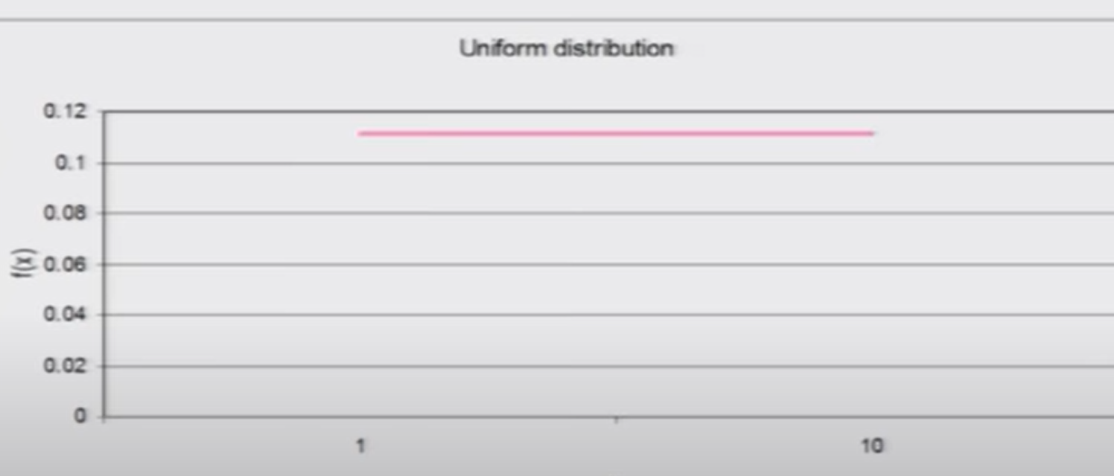
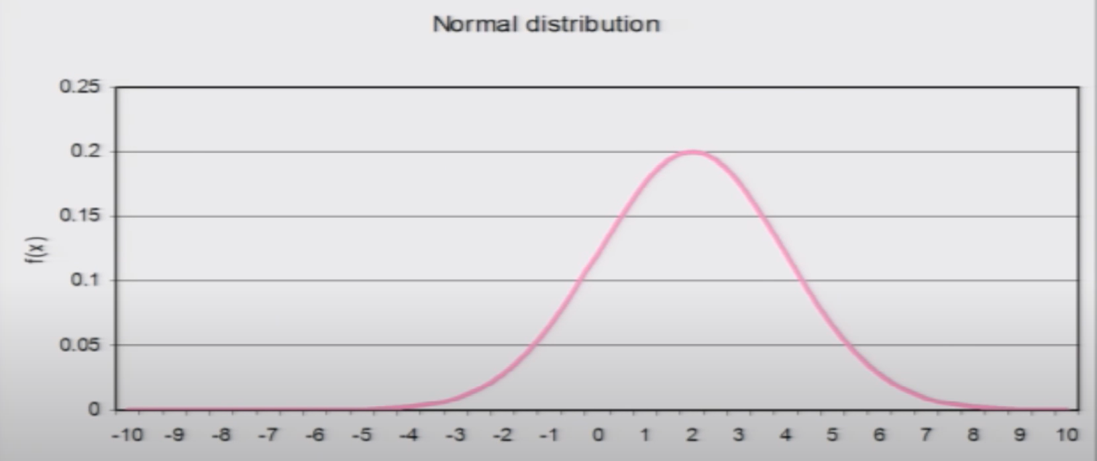
Probability Distributions
Uniform Distribution. All values between a max and min values occur with equal probability.
Normal Distribution. The bell-shaped normal distribution represent many natural phenomena, which depends on many factors.
Notes:
Uniform: choosing any no. between 1 and 10
Normal: average age of std in class 7 n 8 selected at random fromm all ths schools of ktm

Slide 15
Probability Distributions
Triangular Distribution. There are three parameters- max, min, and most likely values. This distribution is used when no historical data are available.
Poisson Distribution. This describes the number of times an event happens in a specified time period.
No of customer arrival at bank teller counter in specific interval of time
Exponential Distribution. This describes events happening at random times such as failure of machines. The distribution is not affected by previous events.

Slide 16
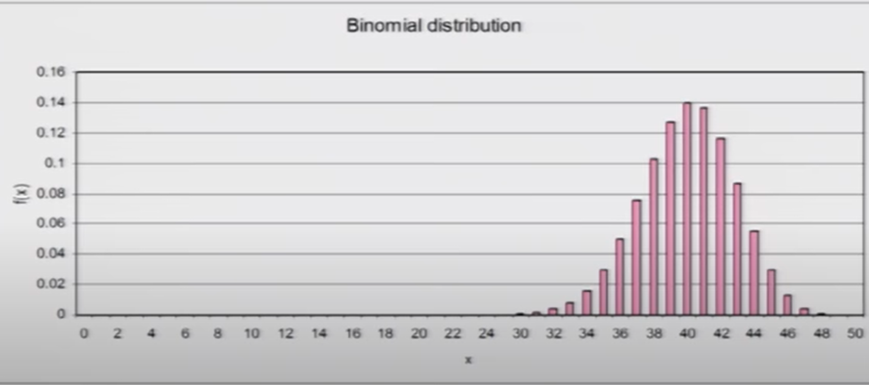
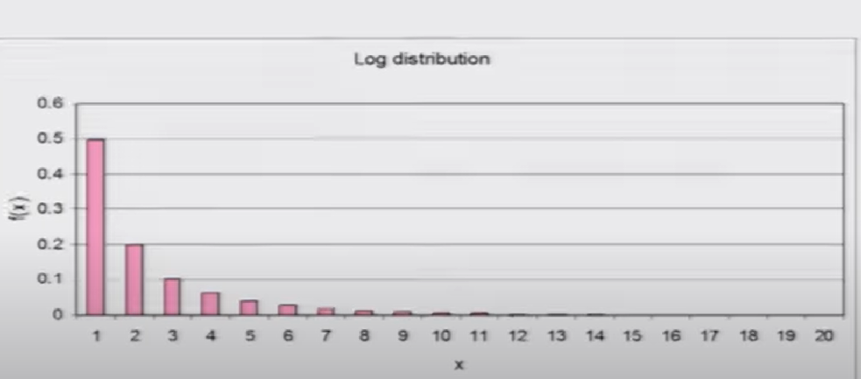
Probability Distributions
Binomial Distribution. This describes the number of occurrences of an event in a fixed number of trials, where only two outcomes can occur for each trial
Eg. Head-tail, good-bad
Lognormal Distribution. This is used in situations where values are positively skewed. Stock prices cannot fall below zero, but can take values quite high. The natural log of lognormal distribution is normal distribution.
Emissions of gasses from engines against fuel type,
Used to represent the distribution of number of item of product purchased by a buyer during a specified interval of time

Slide 17
End of chapter 1
THANK YOU

